Slide 1
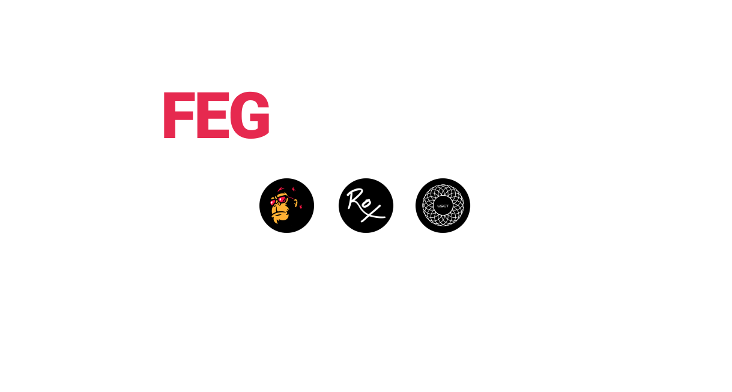

Slide 2
Feg Token Project
FEGtoken is a DeFi project with an ever growing and innovative ecosystem that advances and continuously pushes boundaries. With nearly 1 million holders we are driven to ensure that they, along with anyone entering this space feel secure, rewarded and find the technology easy to use.
FEGtoken is our governance token, launched in January ‘21 on Ethereum and February ‘21 on Binance Smart Chain. FEGtoken is both deflationary and RFI.
More details on fegtoken.com

Slide 3
Released
FEGex
fWrap
Staking
SmartSwap
Auto-Listing Deployer (AD)
SmartDeFi (SD)
ROX Token – the “model home” of SmartDeFi
FEGpresales
Maker Reward and GASrebate Programs
FEGcharts
FEGtrack
FEGfaucet
PASA & ATEITIS Partnerships
FEGcentral
FEGradio
FEGscholars – Financial Literacy Program

Slide 4
FEGex
FEGex is a decentralised cross-chain exchange (fegex.com), built from the ground up with custom coding that is specifically designed to resolve major issues with other popular exchanges surrounding DeFi tokens.
Key Features: Swap, fWraps, Staking, Liquidity, Presales and SmartDeFi tokens Launchpad.
The V1 Decentralised (DEX) aspect of FEGex launched on April 1, 2021.
The V2 Decentralised (DEX) aspect of FEGex launched on June 30, 2021.
The V2.1 Decentralised (DEX) aspect of FEGex launched on August 30, 2021.

Slide 5
fWrap
fWrap allow you to wrap virtually any legacy crypto on the Ethereum or Binance Smart Chains and earn more of them just by holding the fWrap in your wallet. Unwrap at any time back into the original crypto.
The FEG ecosystem has been designed such that all swaps use an fWrap base token. This ensures that the volume and therefore rewards generated by fWrap will continue to be significant.
Available on fegex.com and fegwrap.com

Slide 6
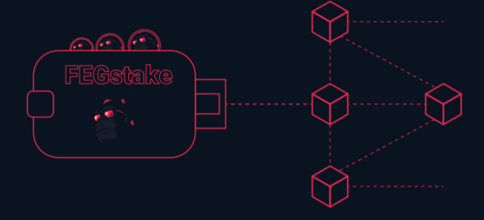
staking
Staked FEG tokens are held securely in the FEG Token staking contract. Stakers are rewarded a share of 0.15% of the dollar value of all sell transactions that occur on the exchange and 0.12% from sell transactions in SmartDeFi.
Stake FEG and earn:
FEG reflections (added directly into your staking pool), fBNB, fUSDT, fETH + fWrap reflections.

Slide 7
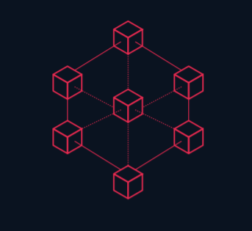
SmartSwap
Swing trade your tokens without incurring taxes! SmartSwap is available for all tokens launched on FEGex and SmartDeFi. The 2.00% tax on FEG Token is incurred when moving into and out of SmartSwap. All other RFI tokens will incur their designated tax percentage when moving in and out of SmartSwap.
Anonymous P2P and swaps between different trading pools S2S are available within SmartSwap.

Slide 8
Maker Reward and GASrebate programs
Maker Reward Program - receive a refund from your purchase while still using 100% of the buying power. With every buy transaction 0.3% of the total BNB (0.5% of the total ETH) used for buying is given back to the buyer.
GASrebate Program - all trading pairs on FEGex will use the GASrebate sell transaction fee of 0.15% to fund the rebate pool for reward distribution for buyers and sellers of each respective token-pair.
The buyer or seller will receive 1/8th of the total BNBback or ETHback pool at the time of their purchase. The return will come in the form of BNB or ETH depending on the respective chain being traded on.
Rewards on Buying - if you buy with over 0.2 BNB (over 0.05 ETH) and hold 20b FEG in your wallet. Rewards on Selling - if you sell with under 2 BNB (under 1 ETH) and hold 20b FEG in your wallet.

Slide 9
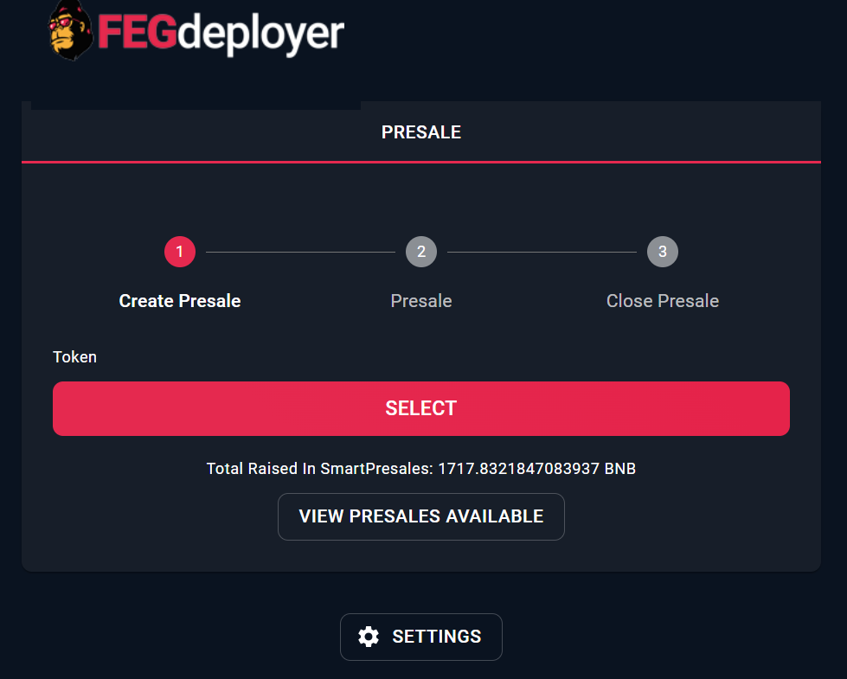
Auto-Listing Deployer (AD)
FEGdeployer allows any ERC-20 or BEP-20 project to list their token on FEGex (fegdeployer.com). Project owners are incentivised to list on FEGex because they earn a percentage of every sell on their pairs.
Supports:
Presales (Whitelist/Public).
Fairlaunch.

Slide 10
Smart DeFi (SD)
Each token created using our SmartDeFi Deployer contains the exchange, lending protocol and asset-backed store of value inside the smart contract, creating a safer and more reliable token.
Token liquidity is held securely inside the token’s own contract, and is inaccessible, makes it impossible to rug-pull and eliminates the need for 3rd party liquidity providers.
Every SmartDeFi token is backed by its base asset, providing each token with an ever-increasing intrinsic baseline value. Launch your own SmartDeFi Token in a matter of minutes using the SmartDeFi token template and our FEGdeployer tool.
More details on fegrox.com and smartdefi.com

Slide 11
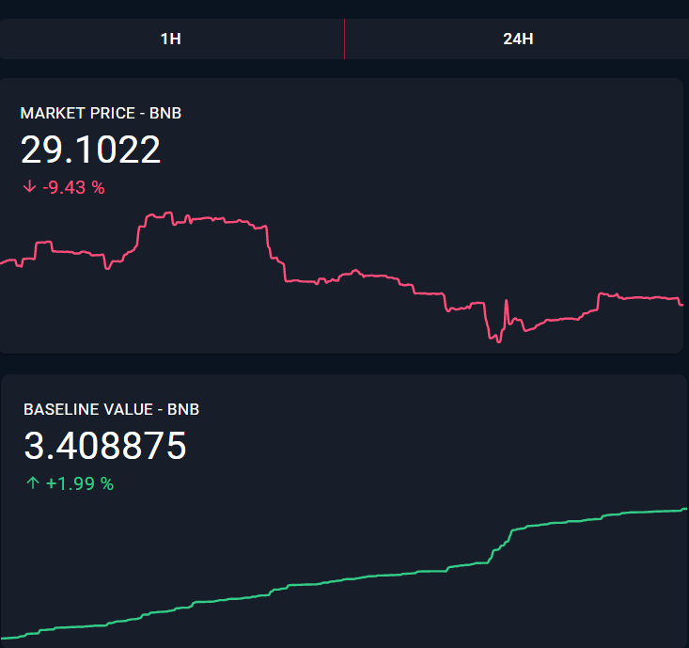
Rox token - The “model home” of SmartDeFi
ROX Token is a revolutionary token and is the world’s first SmartDeFi token. It launched with a total supply of 1,000 ROX on each chain (ERC-20 and BEP-20) on September 2, 2021.
ROX Token has all of the transformative features of FEGex inbuilt along with SmartSwap, Auto-Routing (auto wrap/unwrap)—and more!
More details on fegrox.com and smartdefi.com

Slide 12
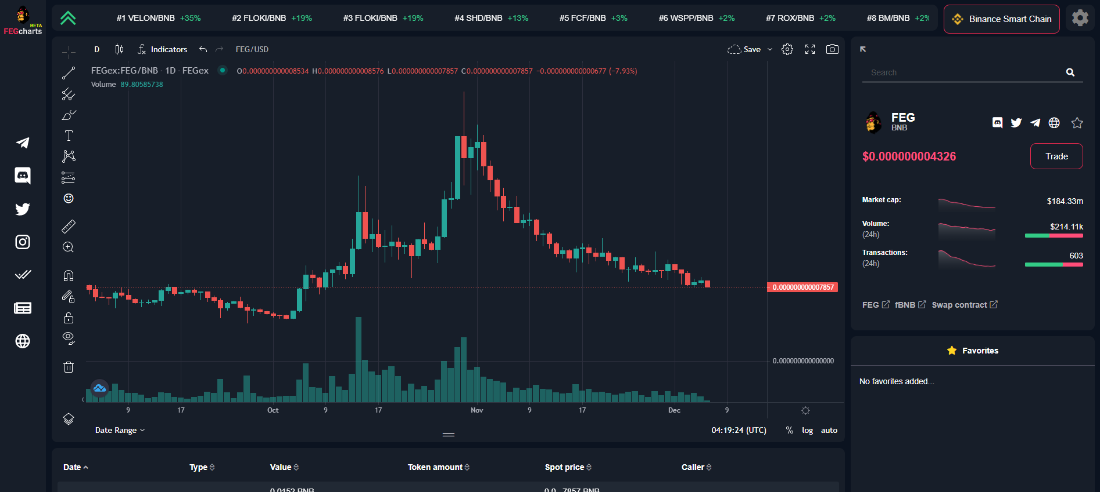
FEGcharts
FEGcharts (charts.fegex.com) is our DEX tool for FEGex. View any FEGex pair in a Tradingview chart while having easy access to market cap and volume information.
Overlay any indicators you need and track transaction history.

Slide 13
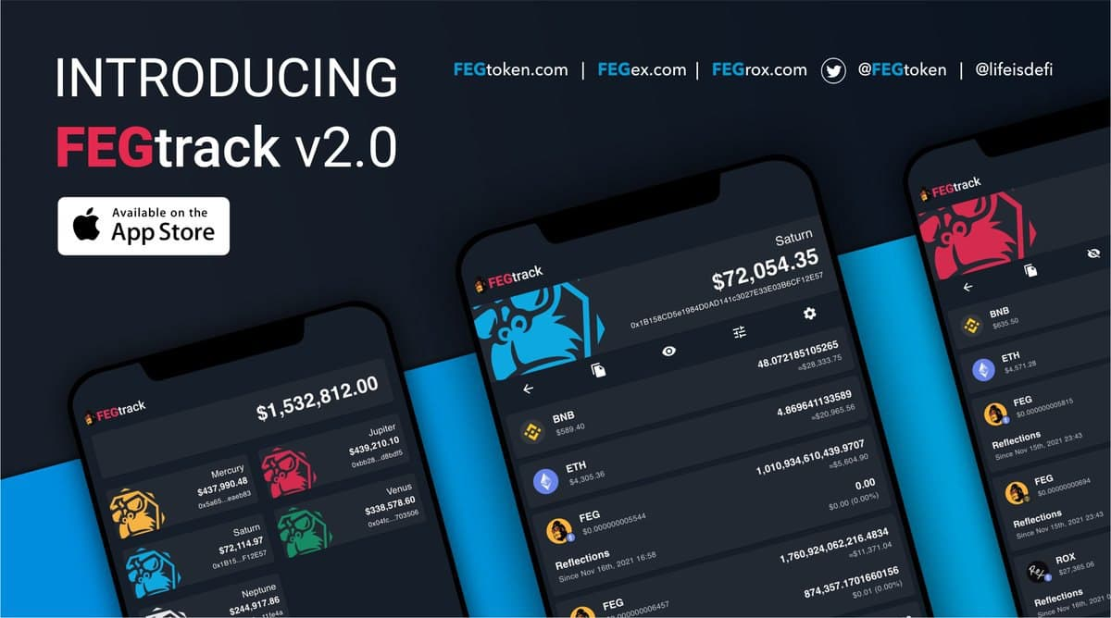
FEGtrack
FEGtrack is our mobile and web-based app for tracking price, reflections and staking rewards.
Developed for both iOS and Android users and allows tracking of all FEGex pairs.
Available at track.fegex.com

Slide 14
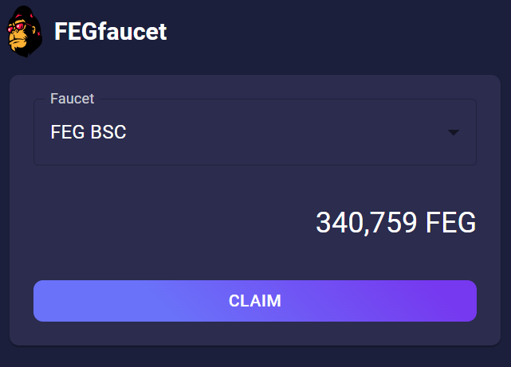
FEGfaucet
FEGfaucet (fegfaucet.com) consists of an initial 22T FEG deposited into a permanently locked system. The faucet collects frictionless transaction rewards in FEG.
Anyone can claim on a first-come, first-served basis once every 24 hours per wallet. The hope is that FEGfaucet will one day be providing over $20.00 (USD) of FEG every minute.

Slide 15

The Pan African Sanctuary Alliance (PASA)
Very early in our journey we partnered with The Pan African Sanctuary Alliance (PASA). It’s a relationship we’re proud of, and one which goes from strength to strength.
PASA has been fighting against illegal hunting while putting efforts into research, education and emergency response regarding wildlife. PASA is the largest coalition of wildlife centres and sanctuaries across Africa. With a network of 23 member organisations in 13 African countries, PASA serves as a united coalition to fight, protect and save humanities closest relatives from the brink of extinction.
To this date FEG was able to provide over 8,000 gorilla meals (more than half a million lbs of food) through the partnership with PASA.

Slide 16

ATEITIS INFORMATION TECHNOLOGY (ATEITIS) PARTNERSHIP
FEG announced a strategic partnership with ATEITIS Information Technology (ATEITIS) to strengthen security and safety of the FEG ecosystem.
ATEITIS routinely performs pen testing, static code reviews, dynamic code reviews, library reviews, configuration audits, event monitoring and other tests to protect all things FEG.

Slide 17
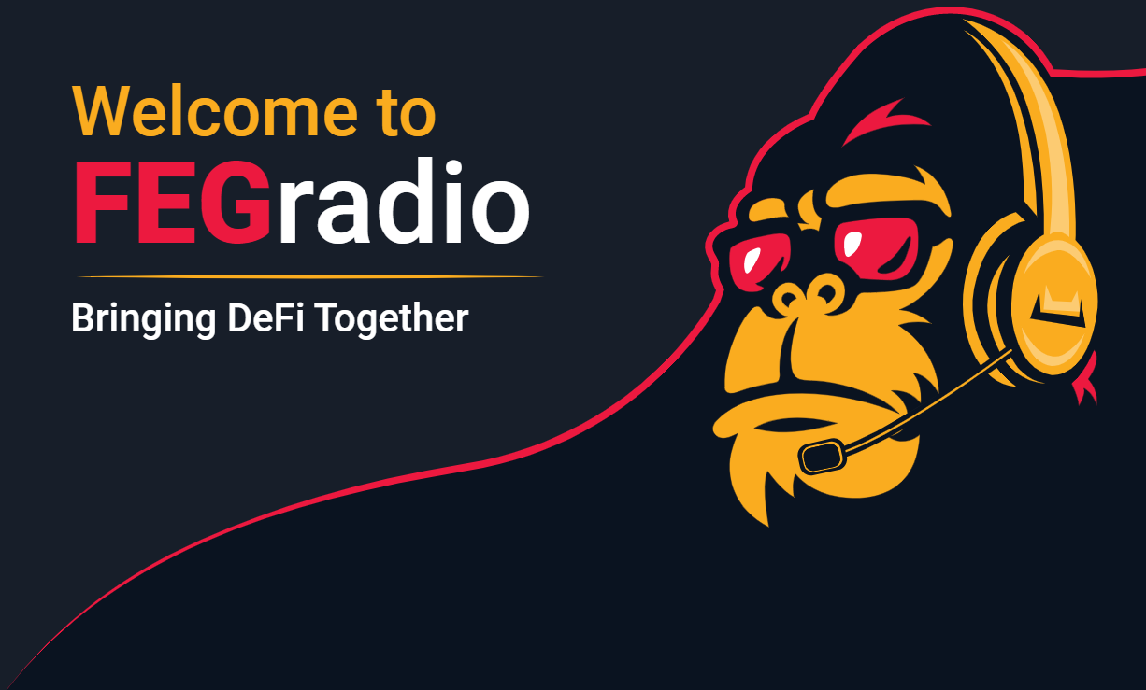
FEGradio
The FEGradio Live program offers guest appearances that enable projects to communicate directly with the FEG community, including the option for giveaways, contests, question and answer sessions, and much more—live on Telegram, fegradio.com, YouTube, and numerous podcast platforms.

Slide 18
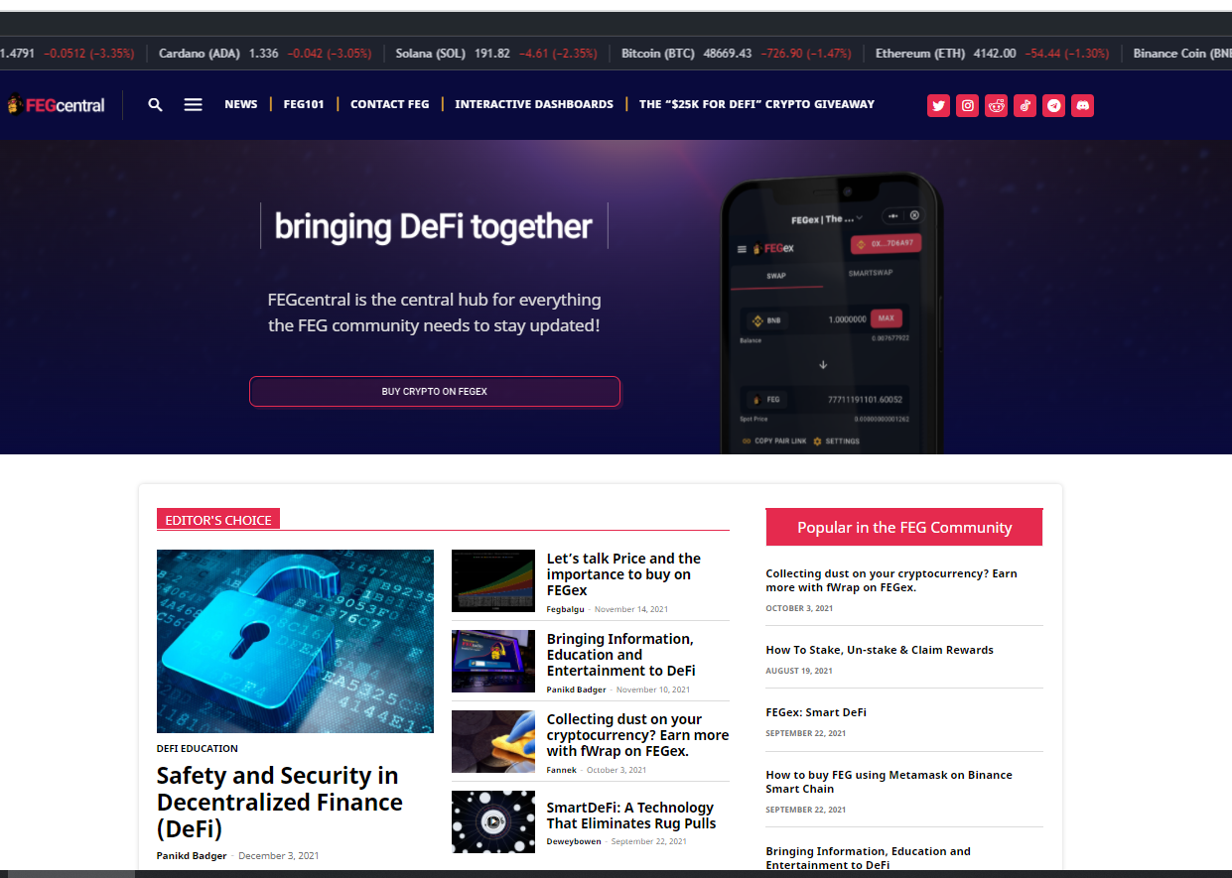
fegcentral
FEGcentral aims to provide the best information about FEG, FEGex and all things related to SmartDeFi and the DeFi community.
The platform runs a 24/7 support chat that allows any trader in the FEG ecosystem to directly connect with the FEGsupport crew.
Available at fegcentral.com

Slide 19

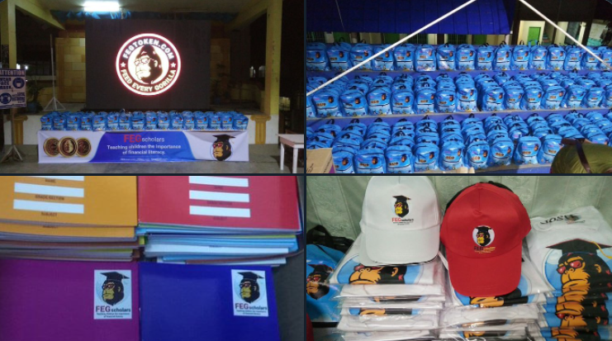
FEGscholars
FEGscholars empowers children and their parents by equipping them with lessons in financial literacy. This will leave a lasting legacy that will change lives for generations.
FEGscholar locally sourced 500 back packs (300 for the Philippines and 200 for Haiti), notebooks and writing tools for students as well as t-shirts, caps, and masks for volunteers.
Launched in December 2021. Our efforts will move from the Philippines to Haiti in February 2022; after which we will continue to expand the initiative globally.

Slide 20
Upcoming releases
SmartDefi Deployer (SD)
SmartLending
New User Interface (UI)
Cross-chain expansion (AVAX, FTM, MATIC) and Bridge
Universal Stable Cent Token (USCT)
2FA
Chiwawa Multi-Verse Partnership

Slide 21

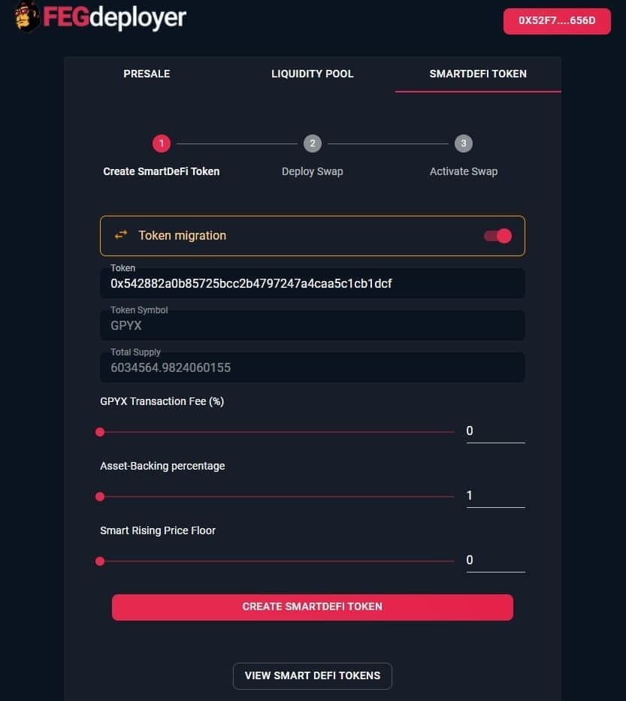
SmartDefi Deployer
SmartDeFi is a new kind of token that is an exchange and token in one. Swap functions are built into the token. 100% of initial liquidity is stored in the contract, and ownership of the contract is immediately and automatically renounced at launch.
All SmartDeFi tokens have an fWrap as their base pair. Furthermore, all SmartDeFi tokens are asset-backed and have a baseline value that can never decrease.
Anyone will be able to launch a SmartDeFi token without hiring developers.
Learn more on fegrox.com and smartdefi.com

Slide 22
SmartLending
Users will be able to use any SmartDeFi token as collateral to take out loans on the token’s baseline value—without having to sell them or having to burn them. Simply use the SmartDeFi loan function to place the SmartDeFi token into collateral inside the SmartDeFi token contract.
SmartLending requires no third party. Nothing can be manipulated externally to exploit the code.
SmartLending is the first lending protocol where the funds and data for ratio calculations are hosted inside the same place, making it the most secure lending protocol ever created.
There is no interest on SmartLending, you are only required to pay back the initial loan. Upcoming release is expected on fegex.com

Slide 23
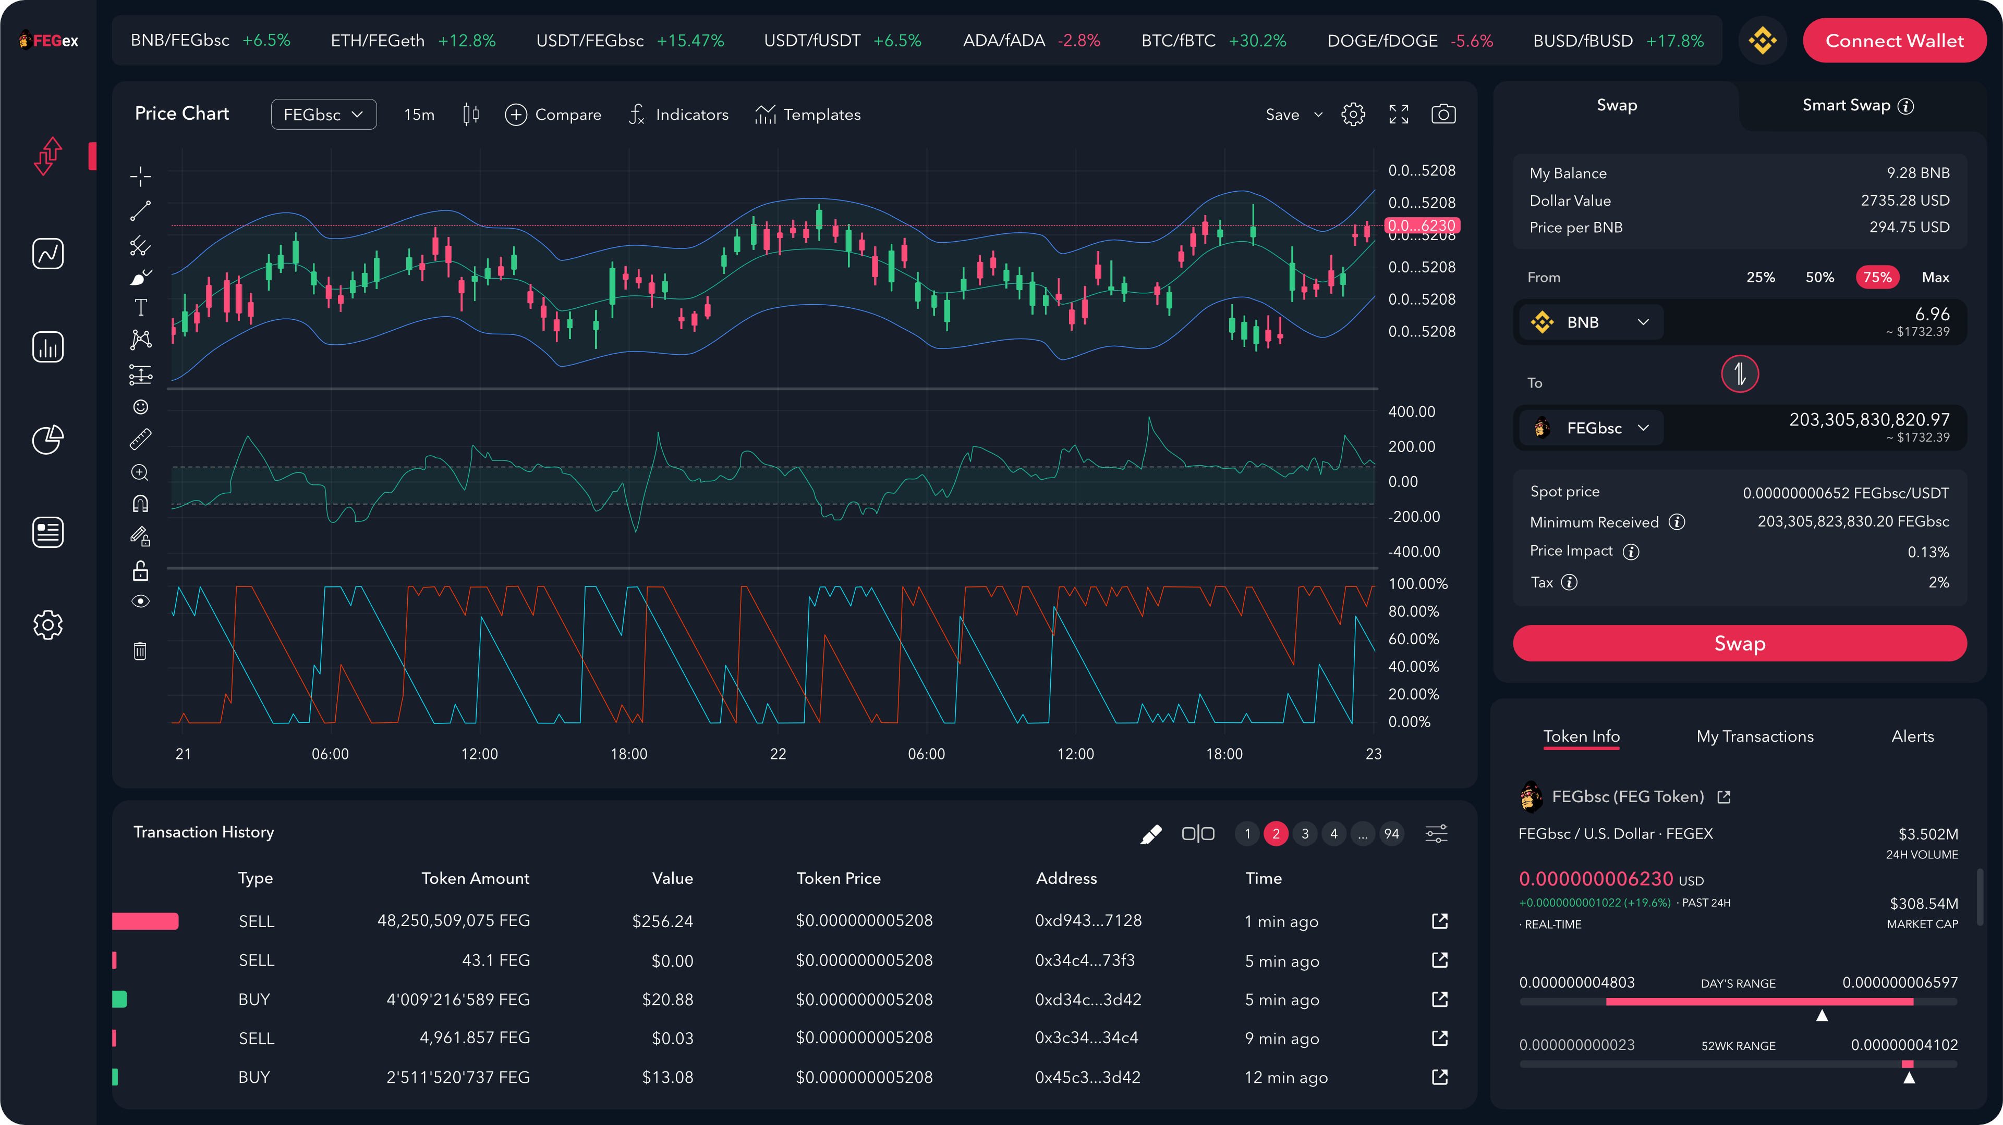
NEW User interface (UI)
New User Interface (UI) for FEGex with integrated FEGcharts, swapping and other core functionalities on the exchange.
Currently, in the final stages of development.

Slide 24
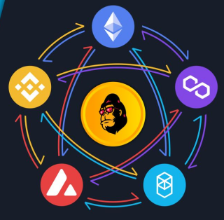
Cross-Chain Expansion and Bridge
FEGex plans to extend support of three more blockchains – Avalanche (AVAX), Fantom (FTM) and Polygon (MATIC) as a result of the on-going development of the cross-chain Bridge.
The development of the Bridge will allow cross-chain swapping between tokens if they provide liquidity dedicated for the bridge.
This will make FEGex a CEXDEX (a centralized feature within a decentralised environment).

Slide 25

Universal stable cent token (USCT)
FEG announced a release of USCT - first decentralised truly stable token.
The FEG ecosystem has taken a big step towards completing a self-sufficient chain in the field of cryptocurrencies and the world of DeFi.
Traders will be able convert their stable tokens to USCT.
More details will be available on usct.com

Slide 26
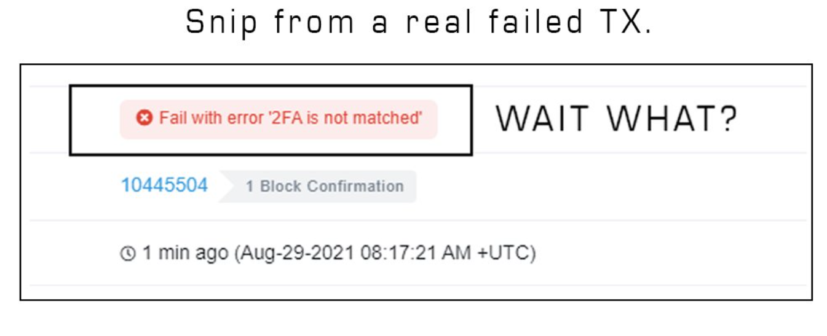
blockchain Two-factor authentication (2Fa)
The lead developer of the FEG project, Fegrox, revealed that he was able to achieve 2FA verification on a blockchain for a wallet that had its seed phrase revealed.
More details on product development using 2FA technology will be released at a later date.

Slide 27

Chiwawa Multi-Verse Partnership
A new partnership has been announced with the Chiwawa – a Multi-Verse Project that will provide metaverse space for Arenas, Stadiums, Games and Convention Centers.
The integration of FEG SmartNFT technology and fWrap system within the Chiwawa Project will benefit FEG Token project through redistribution of the % to the staking and liquidity pools.
The FEG team is working on the development side of implementation to allow user experiences to directly load from the blockchain. This will be the first decentralised Multiverse.
The future of Metaverse is Smart! More details will be released at a later date.

Slide 28

FEG Ecosystem
fegtoken.com
fegex.com
fegdeployer.com
presale.fegex.com
charts.fegex.com
track.fegex.com
fegcentral.com
fegradio.com
fegrox.com
smartdefi.com
usct.com
Follow us on social media
t.me\fegchat
twitter.com\fegtoken
reddit.com\r\FegToken_Official
instagram.com\feg_token

